Slide 1
IE
By: Manasi Indolikar, Gunica Sharma, Saketh Nunna, Sarath Kavitha

Slide 3
Our Product
We made a game that strengthens student’s math skills by giving them practice problems to bridge to the future. Combines knowledge from the past to understand how a potential future may look like. This game also bridges the gap for mathematics which is essential for student’s understanding in tech related industries in the future. Student’s will start at the lowest level and after answering questions correctly, they will move up levels and to win the game, they have to reach the future. The game includes built-in support for teachers to integrate the game easily into classroom settings.
Click here to view the website! (View on desktop please)

Slide 4
Our Unique Selling Proposition
Interactive game for the students starting to learn math. Our game is unique because it combines knowledge from the past and helps the students bridge to the future. It will allow creative thinking as the students will be curious to find out how the future is like. New ideas of inventions and ideas of a future world will spark in the student’s minds.

Slide 5
How It Functions
We developed an immerse app that delivers quick math problems to the student. There are 4 levels in the game where each level emulates a stage of evolution. Students will answer simple math questions and progress through each stage. This app has been designed with younger children in mind with classroom integration being a key part in the development.

Slide 6
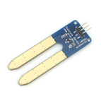
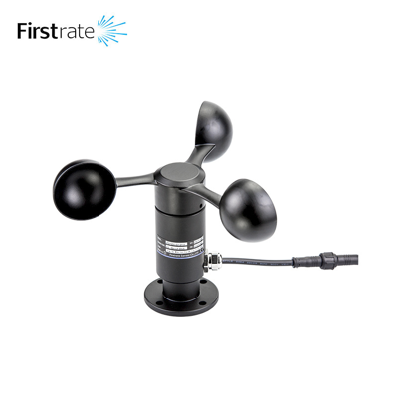
≈
Product Development
≈
As beginners, we all started off by attending the python session that was provided on Webex through the hackathon. Then, we watched several videos online to help us learn as well. We then started to do a few practice problems to enrich our python knowledge. Later on, we moved on to brainstorming an idea for our game. We considered the different fields our product could make an impact on and after much deliberation we came upon a consensus that we should target the online education sector for kids.
≈

Slide 7
≈
Product Development
≈
The first step to the process was to develop a code. We downloaded Jupyter Notebook and learned how to run cells, clear output, and run programs. We all started to experiment with our code and pitched in our ideas to enrich it. We also learned how to deal with the several different errors, including type errors, syntax errors, key errors, and value errors. As beginner coders we had to consult the mentors multiple times to inquire about questions we had. The help provided aided in our understanding and allowed us to better develop the application.
≈

Slide 8
≈
Product Development
≈
We then learned how to use WIX to design and implement our design. We learned how to embed code into a program that can run it on the website. The program we used to embed the file is called Sculpt. After the process of coding and embedding was figured out we started to work on development of the site adding graphics and figuring out the general structure, look and feel of our site. This whole process took more than 36 hours with much deliberation and error. Our last task to tackle was our presentation and present our sales pitch.
≈

Slide 9
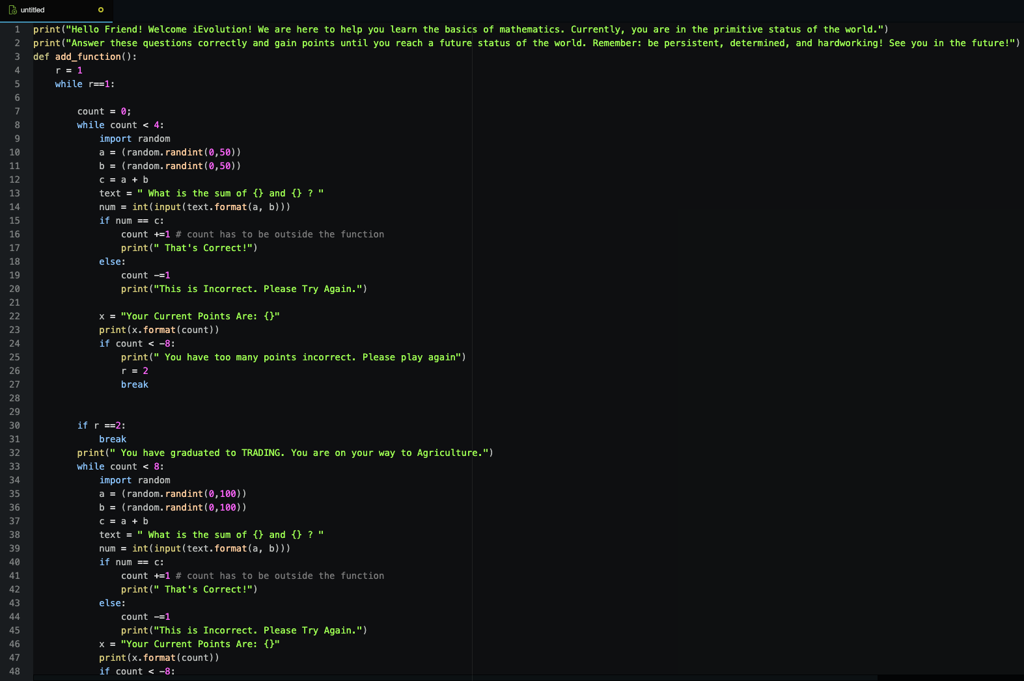
≈
Code

Slide 10
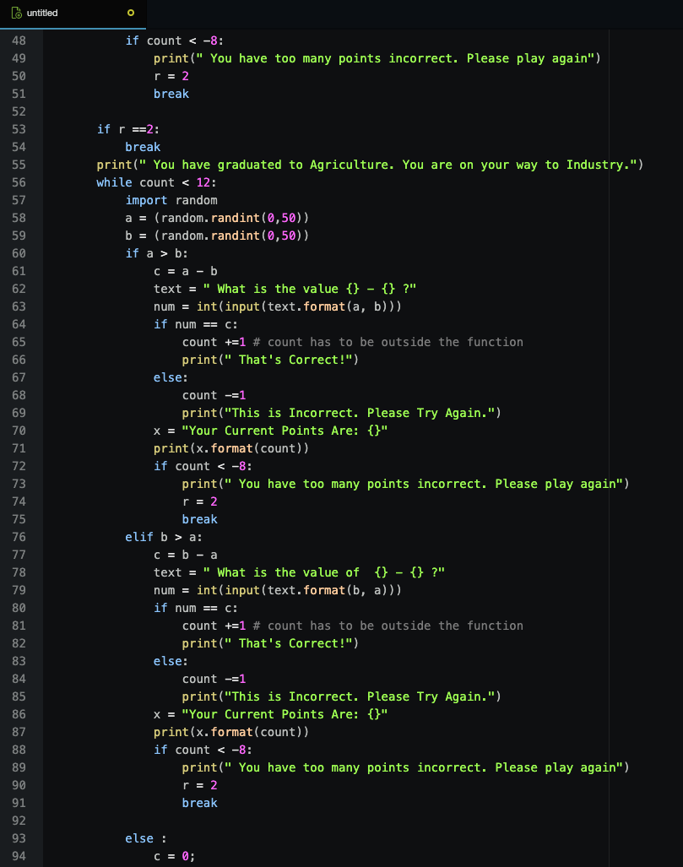
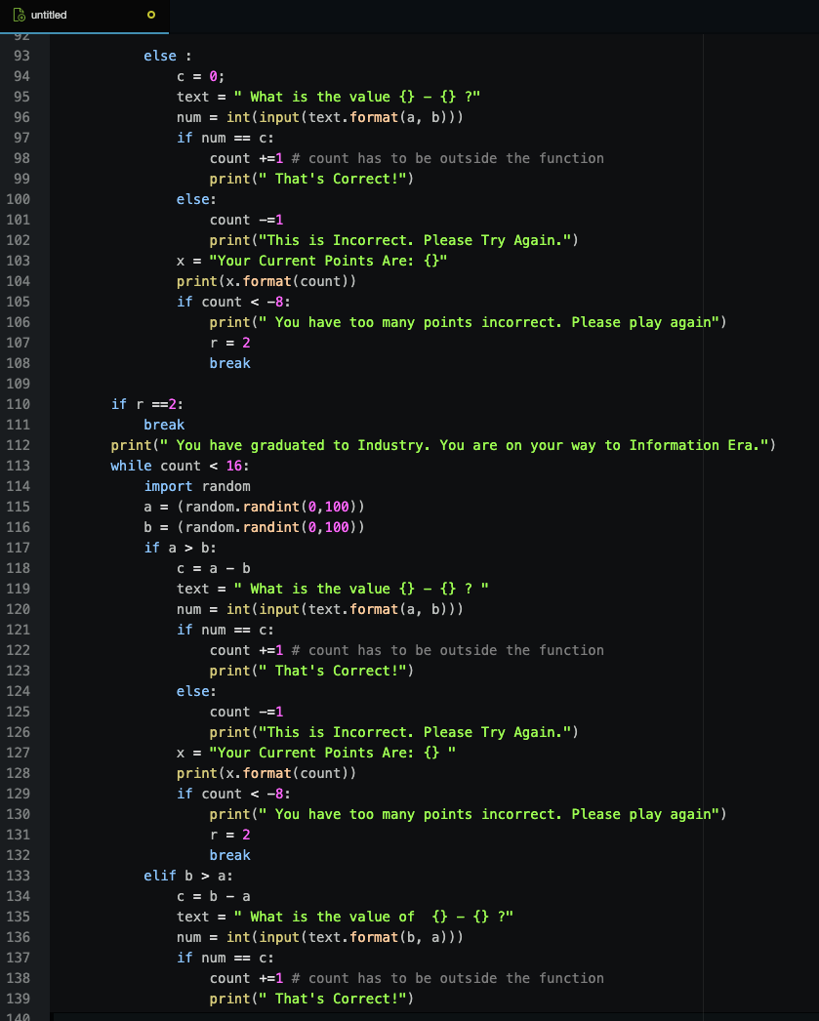
≈
Code

Slide 11
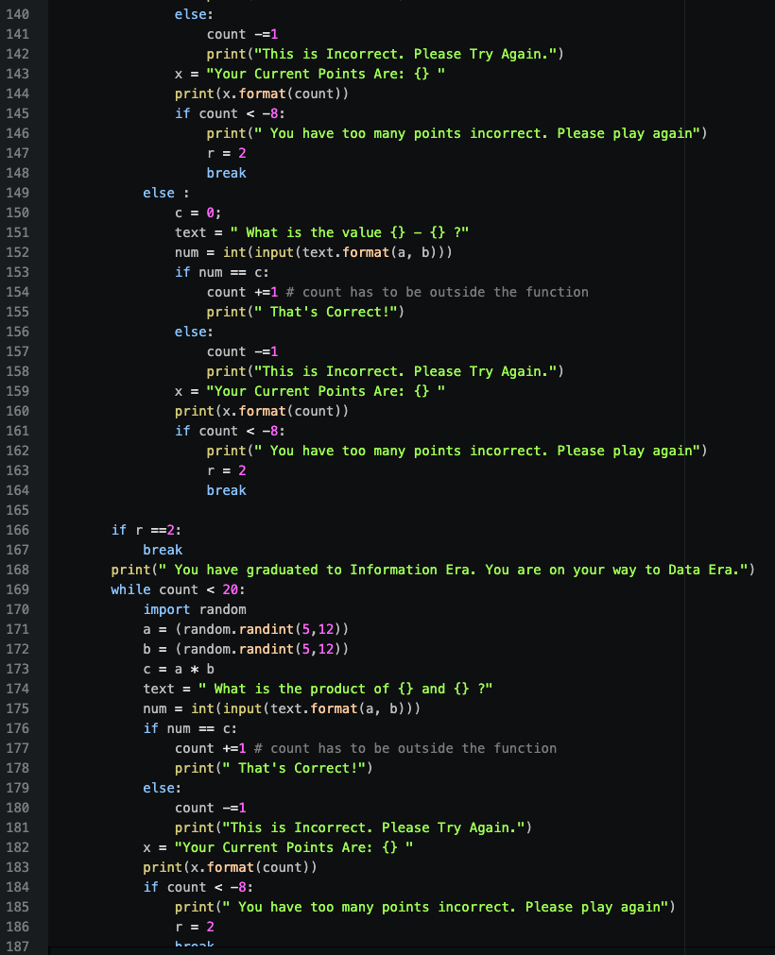
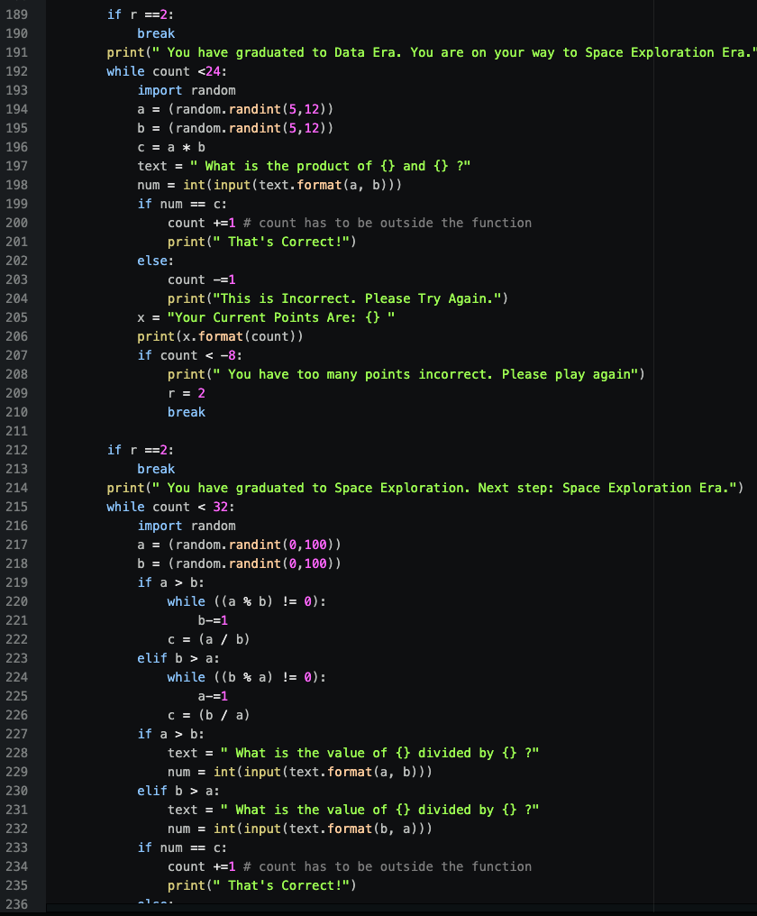
≈
Code

Slide 12
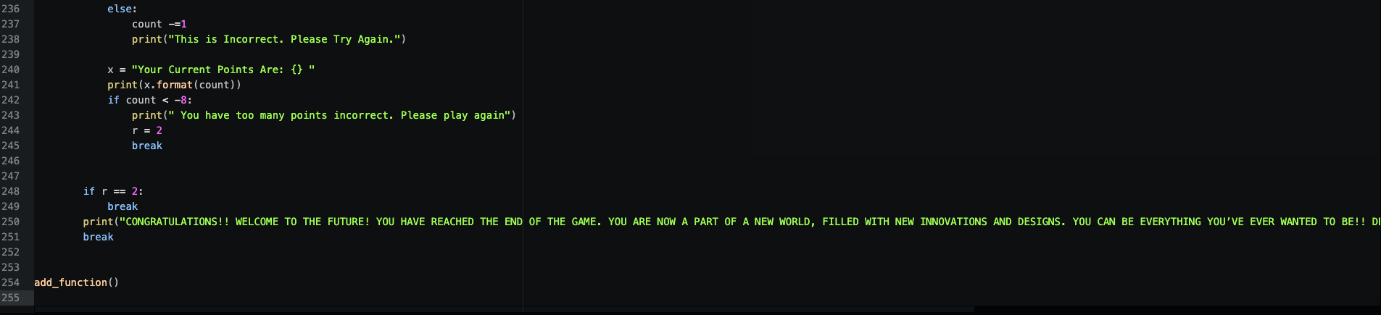
≈
Code

Slide 13
Detailed Analysis
For our game our target market is elementary students, elementary school teachers, and homeschooled students. We want to ensure that we are allowing our customers to have a pleasurable experience as they move along the learning process while considering the effect of our product. Their information search can come from sponsorships from social media influencers that promote our website on their page. When our customer decides to evaluate their choices, they can look at other games on the internet. However, our game will have unique characteristics such as a reward system mechanic that will visualize one’s progress as the user gets more questions correct. Moving on, the game is free. Once our customer has learned the basics of mathematics, we hope to see them satisfied and content enough for them to subscribe for newer games and buy our premium package with videos and tutorials teaching them math. One of the main problems of our website is the fact that our company will have to learn how to cater to our market. Since we are a start up, it can be difficult to attract customers without the right marketing and customer service.

Slide 14
Industry Analysis
As of 2020 the market for virtual learning is expected to amass $7.9 billion dollars with educational apps being some of the most popular apps in today’s world. Apps like Duolingo and Google Classroom reached hundreds of millions of downloads on the App and Play Stores. Online websites for education have also risen significantly, most visited webpages including Udemy, Coursera and Quizlet. Furthermore many of these sites and apps are well reputable and known to partner with other educational corporations an example of this can be seen between the Khan Academy and College Board. The industry is highly competitive and on a steep rise in recent years. It is projected that by 2026 the industry will reach an astronomical worth of over 375 billion dollars. With North America constituting 40% of the market. The trend in recent years has been toward workplace and school readiness with apps emerging for children and adults alike. The global market for such industries is also on a steep rise especially in countries like India which have a global growth rate of over 10% and the CAGR eLearning market estimated to be around 10% until 2025. The academic sector constitutes to 50% of the industry and is projected to grow even more every year. The opportunity for success is imensive with a rising market and education moving online on a global scale factors for success will include scalability and a strong outreach and support to our consumers.

Slide 15
Finance and Location
How we plan to finance our venture:
Partnerships with educational companies both privates and non-profits.
First year will be free then premium plans with added features will be provided.
Location of business:
Global scale (world-wide) hosted from North America (USA).

Slide 16
The product, price, place and promotion for our business
Our product will be free for its users. It will be distributed to schools and educators for use. As our user base grows, we wish to engage in collaborations with those educators for the app’s further development. Since our product is on the web, its distribution will be easy to do. With our price combined with and the ease of distribution, our product can be easily accessible. To promote our product furthermore, we will work with school districts to include our app as a resource for students on their school websites. This is a great way to promote the app.

Slide 17
Marketing Plan
In our marketing plan, we will use social media to publicize our website. We will make a Facebook account for our website and explain the importance of education and hands on learning. We will also use Instagram and various other social media platforms to market our website. On Instagram, we will post on our story daily, posting polls about our website, promoting it and adding educational games on it as well. We will make posters that emphasize the importance of math by displaying various individuals of different cultures, backgrounds around the world who use our game. We will also advertise discounts, and state that a part of our profits will be donated to a charity in need. We will also network to nearby schools and at our workplaces as well. Here, we will be placing mini posters with our pictures of our website and everyone will be getting a card with a link to our website, and contact information with our company name, location, and current deals. We will send texts, and emails when a customer signs up with us giving them special discounts throughout the year. Lastly, we will have promotions with bogo (buy one subscription get one) deals and we will also have flash sales every once in a while, where we will have the opportunity to get new customers, increase revenue, and get future turnover. This is a really good way to catch new customers.

Slide 18
SWOT Analysis
Strengths:
Our website/company will run online so it can have a wide audience and everyone can access the games during COVID-19 especially.
Wide range of intellectual skills can be obtained, from math to history, to english skills.
Diversified audience
Helpful resource for teachers and students of all ages who are starting to learn math.
Weaknesses:
Lack of Capital
Lack of advanced math skills
Too dependent on the internet
Opportunities
Can expand by adding in new material for the students to learn through games.
Expanding into more complex online platforms
Threats
Many competitors
Quick change of technology

Slide 19
Why is it a bridge to the future
Our game is bridging to the future because it allows students to think creatively on an online learning platform where they are able to play games and enrich their math skills. Student’s are able to learn about the past and how the eras have significantly changed over the decades. Students will then be able to use this knowledge to understand the possibilities that the future will obtain, in addition to having creative thoughts and imaginations of inventions they can create as well.

Slide 20
What Have We Learned
This hackathon has taught us a lot, everything from the basics of python to learning how to create a website. We’ve put in all our creative minds and created a truly amazing product. Some skills we’ve learned are how to run Jupyter Notebook, WebApp development, principles of marketing, and most of all we’ve learned how to create an online product as a team. This has been an amazing experience for all of us in the team and we would love to do it again. Hope you enjoyed our presentation and product.

Slide 21
Thank you

Slide 22
Sources
https://www.gminsights.com/pressrelease/elearning-market
https://elearningindustry.com/growth-of-the-elearning-market-gamut-size
Our complete business plan:
https://docs.google.com/document/d/13LaQu34jW-wmqopIzwRdQZ58p7Tl1SXNMgkZmgu_bzE/edit?usp=sharing

